Slide 1

SOLAR MOBILE CHARGER WITH BATTERY LEVEL INDICATOR
PROJECT ASSOCIATES:
K.HARSHIKA SAI KUMARI 23NG5A0408
K. SRIVALLI PADMA 23NG5A0410
N.LAKSHMI BHAVANI 23NG5A0416
T.LAKSHMI DURGA 23NG5A0427
V. VINILA 23NG5A0428
Department of Electronics and Communication Engineering

Slide 2
CONTENTS
1. INTRODUCTION TO EMBEDDED SYSTEMS
2. EXISTING SYSTEM
3. PROPOSED SYSTEM
4. PROJECT OBJECTIVE
5. PROJECT DESCRIPTION
6. REQUIREMENTS
6.1 SOFTWARE
6.2 HARDWARE
7. COMPONENTS
8. BLOCK DIAGRAM
9. CIRCUIT DIAGRAM
10. CODE EXPLANATION
11. OUTPUT
12. ADVANTAGES
13. APPLICATIONS
14. CONCLUSION

Slide 3
1. INTRODUCTION TO EMBEDDED SYSTEMS
An embedded system is a microcontroller-based system designed to perform specific tasks.
It is a combination of hardware and software that is embedded into a device to perform a dedicated function.
These systems operate in real-time and are widely used in automation, consumer electronics, automotive systems, and medical devices.
Arduino is a popular platform for embedded system development due to its simplicity and flexibility.

Slide 4
2. Existing System
Traditional mobile chargers use grid electricity.
No battery level indication.
Inefficient in power management.
No use of renewable energy.

Slide 5
3. Proposed System
Mobile charging using solar energy.
Arduino-based battery voltage monitoring.
LED indication for different battery levels.
Portable and energy-efficient design.

Slide 6
4. PROJECT OBJECTIVE:
To design a portable mobile charger powered by solar energy.
To monitor the battery voltage using an Arduino-based system.
To indicate battery levels using different color LEDs.
To promote renewable energy usage in embedded systems.
To provide a low-cost, energy-efficient alternative for mobile charging.

Slide 7
5.PROJECT DESCRIPTION
A solar mobile charger is an eco-friendly alternative to conventional phone chargers.
It converts sunlight into electrical energy through a solar panel and stores it in a rechargeable battery.
This system allows mobile devices to be charged without dependence on electricity from the grid.
Integrating an Arduino allows for real-time monitoring of the battery voltage.
LED indicators provide a visual representation of the battery level, enhancing usability and safety.
The project combines the benefits of renewable energy and embedded systems for practical and educational use.

Slide 8
6.REQUIREMENTS
6.1 SOFTWARE
- Arduino IDE for programming
- Tinkercad for simulation (if used)
6.2 HARDWARE
- Arduino UNO
- Breadboard
- Solar Panel
- Battery
- LEDs
- Diode
- Resistors

Slide 9
7.Components
Solar Panel
9V Battery
Arduino UNO
LEDs (Red, Yellow, Green, Orange)
Resistors (10kΩ, 220Ω)
Diode (1N4007)
USB cable and connecting wires

Slide 10

LED (Light Emitting Diode)
Working Principle:
Emits light when forward biased
Applications:
Indicators
• Status displays
• Signaling systems

Slide 11
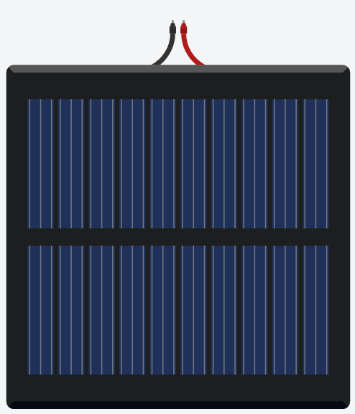
Solar Panel:
Working Principle:
Solar Panel: Converts sunlight into electrical energy (DC voltage).
Applications:
Used in solar lights,
solar home systems,
calculators.

Slide 12

Diode (1N4007):
Working Principle:
Allows current to flow in one direction only, preventing reverse discharge from the battery.
Applications:
Used in almost all electronic circuits for control and protection.

Slide 13
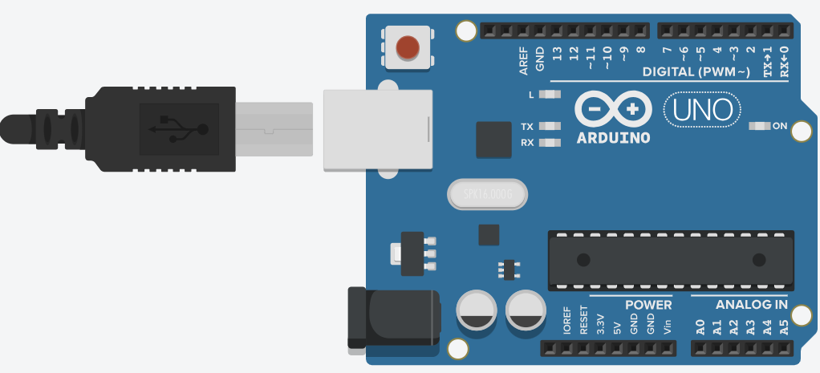
Arduino UNO:
Working Principle:
Reads voltage and controls LED outputs.
Applications:
Home automation,
robotics,
sensor interfacing.

Slide 14
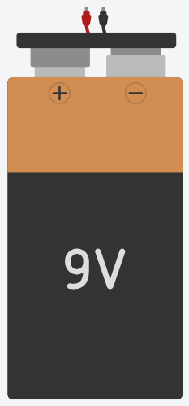
Battery:
Working Principle:
Stores the solar energy to power the charger.
Applications:
Energy storage for mobile,
remote
and emergency devices.

Slide 15
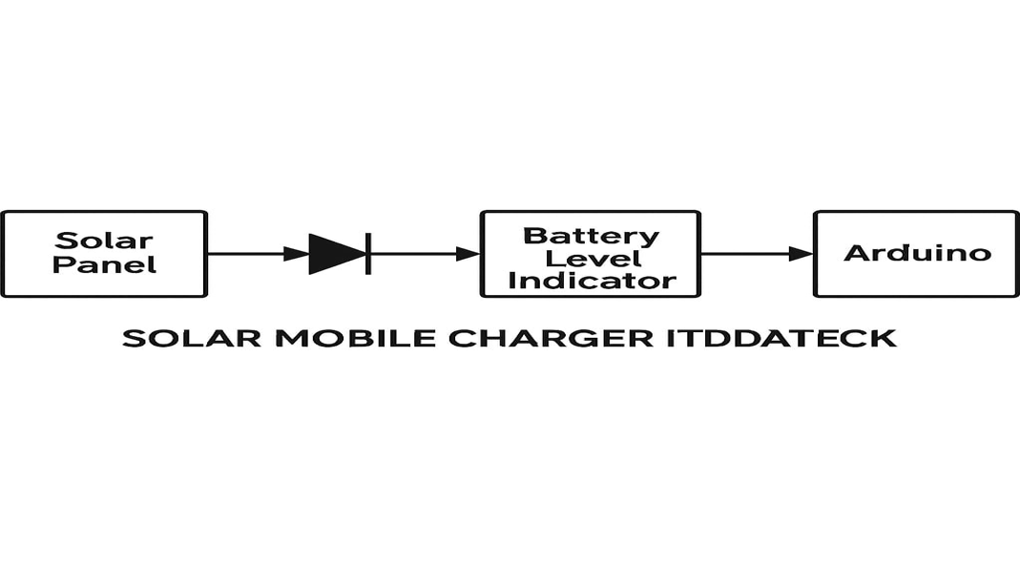
8. Block Diagram
[Solar Panel] --> [Diode] --> [Battery] --> [Voltage Divider] --> [Arduino UNO] --> [LED Indicators]

Slide 16
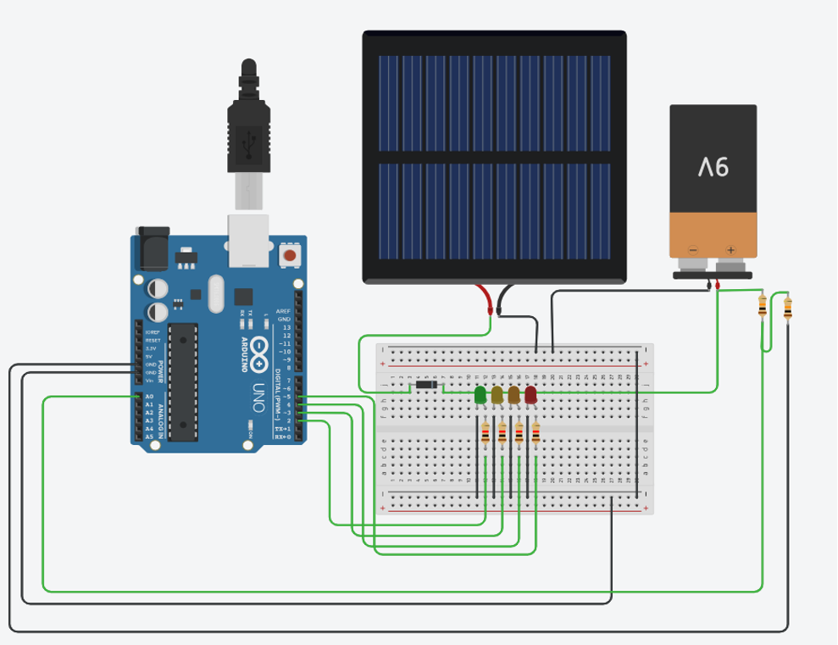
9. Circuit Diagram
- Include actual image or draw with Fritzing/Tinkercad
- Battery to Arduino A0 via resistor divider
- LEDs to digital pins (e.g., D2–D5)
- Resistors in series with LEDs

Slide 17
10. CODE EXPLANATION
Input String will store the text input from the Serial Monitor.
voltage will store the converted float value (e.g., 7.2).
Define the pins connected to LEDs.
Even though battery Pin (A0) is defined, it's not used in this code since you're manually entering the voltage.
Sets all 4 LED pins as output.
Starts the serial communication with baud rate 9600.
Prints a message to prompt the user to enter voltage.
Waits for the user to type a value and press Enter in the Serial Monitor.

Slide 18
Reads the input until a newline character (\n).
Converts the text string to a float (e.g., "8.2" becomes 8.2).
Shows the user what voltage they entered (2 decimal places).
Before lighting any LED, turn all LEDs OFF first.
If voltage is below 6.5V, RED LED turns ON and prints "CRITICAL".
6.5V to 7.49V → Orange LED indicates Low battery.
7.5V to 8.49V → Yellow LED indicates Medium level.
≥ 8.5V → Green LED means Battery Full.
Prints a separator line in Serial Monitor for clarity.
Ends the if (Serial.available()) block and loop() restarts.

Slide 19
11. Output
Serial Monitor displays real-time battery voltage
LED color changes based on voltage:
<6.5V: RED (Critical)
6.5V–7.4V: ORANGE (Low)
7.5V–8.4V: YELLOW (Medium)
≥8.5V: GREEN (Full)

Slide 20


Slide 21
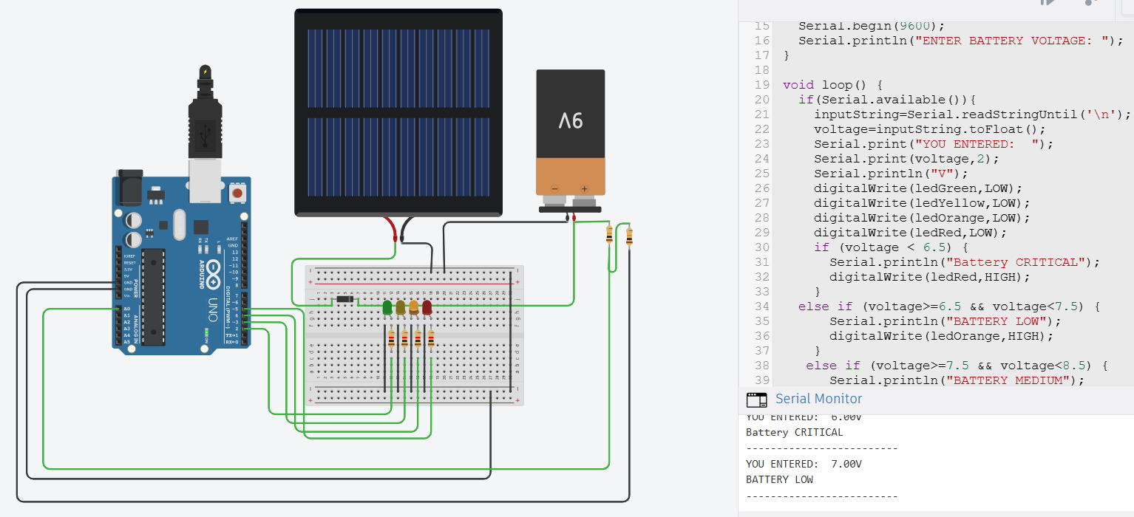

Slide 22


Slide 23
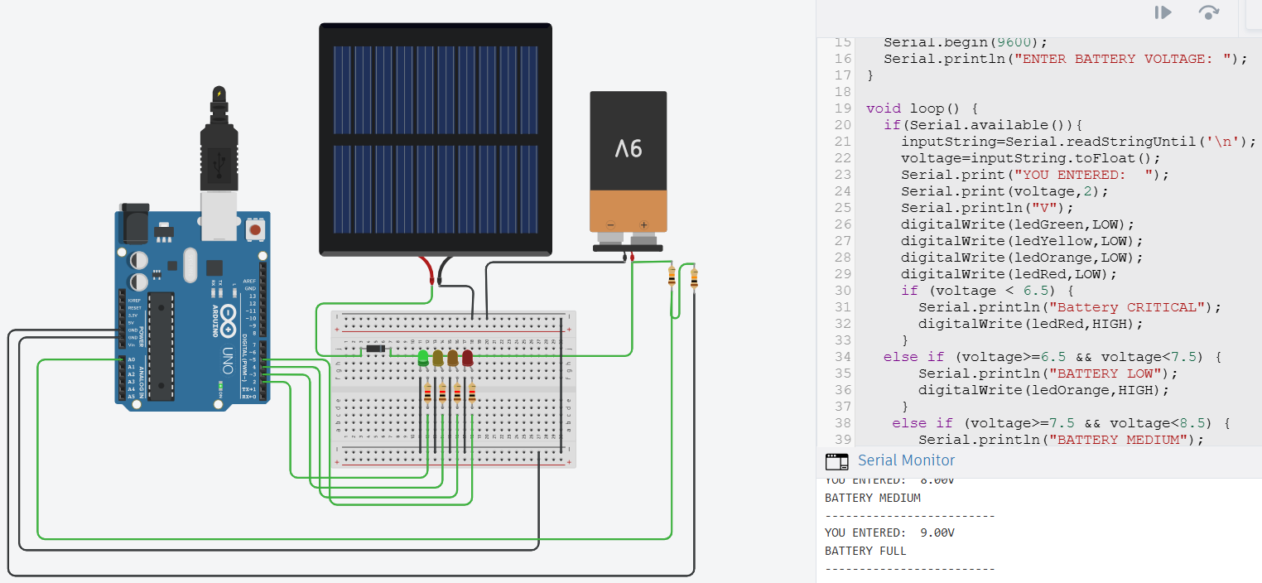

Slide 24
12. Advantages
Uses renewable solar energy for charging
Displays battery level with simple LED indicators
Portable and cost-effective design
Reduces dependency on electricity
Ideal for remote and rural locations

Slide 25
13. Applications
Emergency mobile charging during power outages
Useful for travelers and outdoor use
Can be used in rural/off-grid areas
Demonstration project in educational institutes
Promotes use of solar and embedded systems

Slide 26
14. CONCLUSION
The Solar Mobile Charger with Battery Level Indicator demonstrates a practical approach to integrating renewable energy with embedded systems.
It not only provides an eco-friendly solution for mobile charging but also ensures user awareness of the battery status.
The project promotes sustainability, low-cost technology, and serves as a great learning model for students and hobbyists.
It successfully showcases the capabilities of Arduino-based automation for real-world applications.

Slide 27
QUERIES ?

Slide 28
Thank You

